Slide 1
ONLY DESIGN CAN SAVE US NOW

Slide 2


What it will be discussed?
How to find an useful solution in the field of education?
User identification
User need assessment
Solution Identification
Pretotyping

Slide 3

User identification - Methods
Quantitative methods
Scientific Literature
Google Trend
World Bank Open Data
Qualitative methods
Personas
User Stories (abandoned)
Final choice
SDG framework
(Sustainable Development Goals) from ONU

Slide 4
User identification - Results
Through the usage of both quantitative and qualitative methods, the following users’ list was identified.
User | Need | Goal
A non wealthy student | Needs an economical help to afford scholar and extracurricular expenses | to be able to extend his/hers/their education
A student with disabilities | Needs to receive same possibilities and assistance in education than other students | to feel included and accomplish their educational milestone as his/her/their peer
An LGBTQ+ student | Needs the educational institution to increase awareness about LGBTQ+ topic and to avoid possible acts of discrimination and violence against them | to feel safe, included and accepted by others
A teacher | Needs extra courses offered by school to learn new teaching methods and to stay up-to-date | to better involve students in his/her/their course
A professional | Needs to improve and update his/hers/their professional skills | to improve their professional process and employability

Slide 5
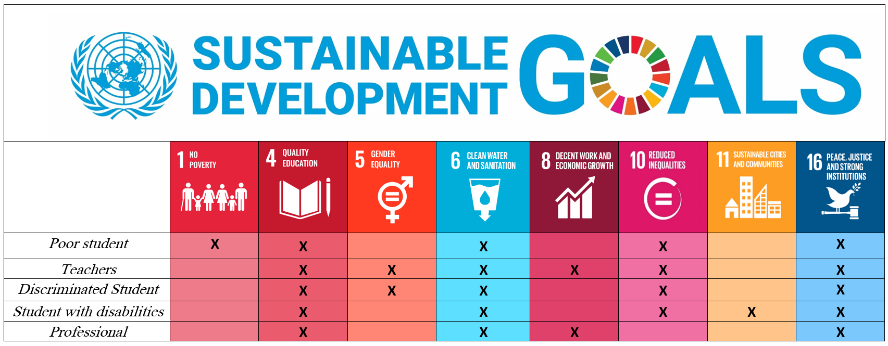
User identification - Results
The next step was to apply the SDG framework.
It was associated a need to a category of possible users, in order to have real needs and not “first world problems”.

Slide 6

User needs assessment
Number of users
Geopolitical Region | Total number of young people | Total Number of students with disability
Italy | 5.660 (appr.) | 1.243
European Union | 74.000 (appr.) | 18.278
About 25% of young people have disabilities, which exemplifies how important it is to provide these
people with the education they need.
Table 4. Percentage of Students with disabilities in Europe and Italy (Source: Eurostat and Istat databases.)
In order to identify this type of students, diverse national (e.g. Istat) and international statistics (e.g. Eurostat) were consulted to identify the percentage of students with disabilities on the total number of young people between 13 and 25 years old.

Slide 7
User needs assessment
Importance
Methods: Maslow’s pyramid and ERG theory adapted into quantitative methods to estimate importance
Maslow’s pyramid |  | ERG theory
Needs | Importance value | Needs | Importance value
Physiological needs | 10 | Existence needs | 10
Safety needs | 8
Love needs and relatedness | 6 | Relatedness needs | 5
Esteem Needs | 4
Self actualization | 2 | Growth needs | 2

Slide 8
User needs assessment
Confidence
Are the collected data reliable and valid?
How dependable are this data?
Do they come from trusted sources?
For students with disabilities, it was chosen to take the data from reliable sources to be sure to do as much data-centered research as possible.
A very important source for this research was the Eurostat databases, with data regarding people with several disabilities and, specifically students with disabilities.

Slide 9
User Need Assessment - Final Decision
Needs | Number of users (est.) | Importance | Confidence | Final score
Equality (gender and identity) | 0.08 | 0.83 | 0.85 | 0.05
Equality (disabilities) | 0 | 1 | 1 | 0
Expand personal knowledge without a lot of money | 0.33 | 0,5 | 0,28 | 0.04
Find a new teaching method | 1 | 0,4 | 0 | 0.004
Expand personal knowledge and balance work between courses and private life | 0.39 | 0,2 | 0,28 | 0.02
In the end it has been preferred to focus only on students with disabilities and their need (equal education) more specific need in the educational field than LGBTQ+ students
Values normalized using Min-Max normalization

Slide 10
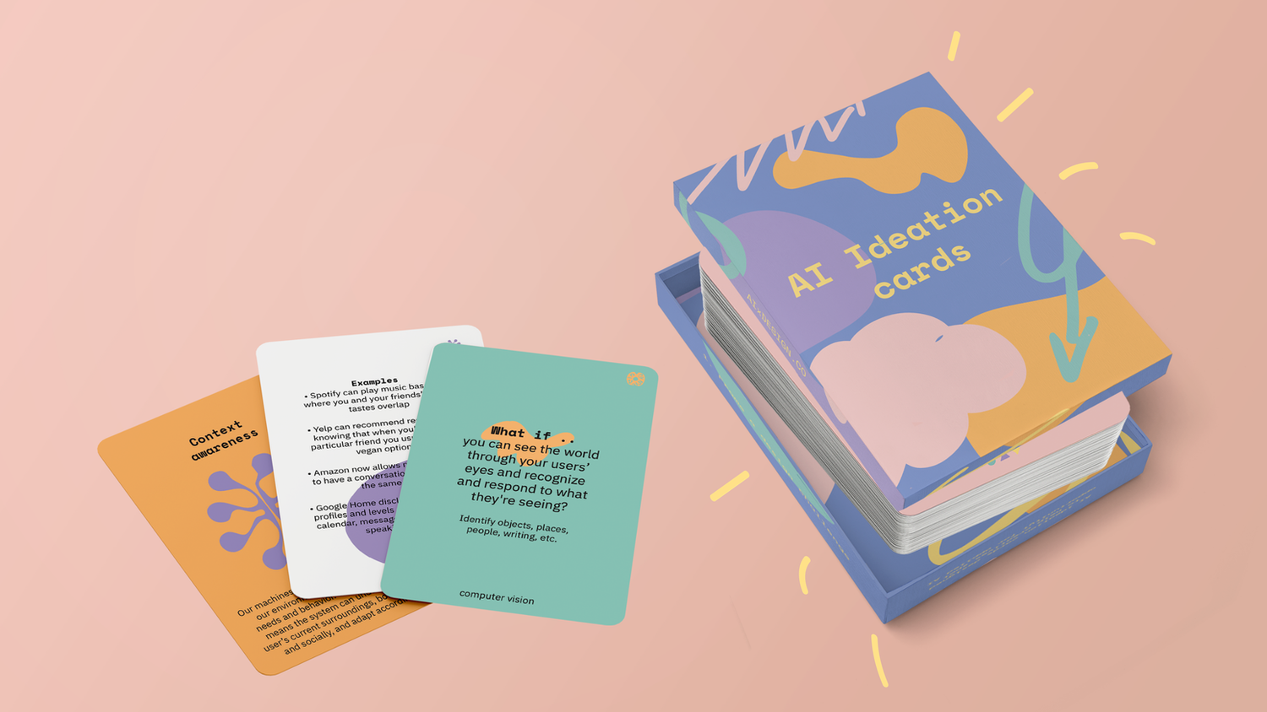
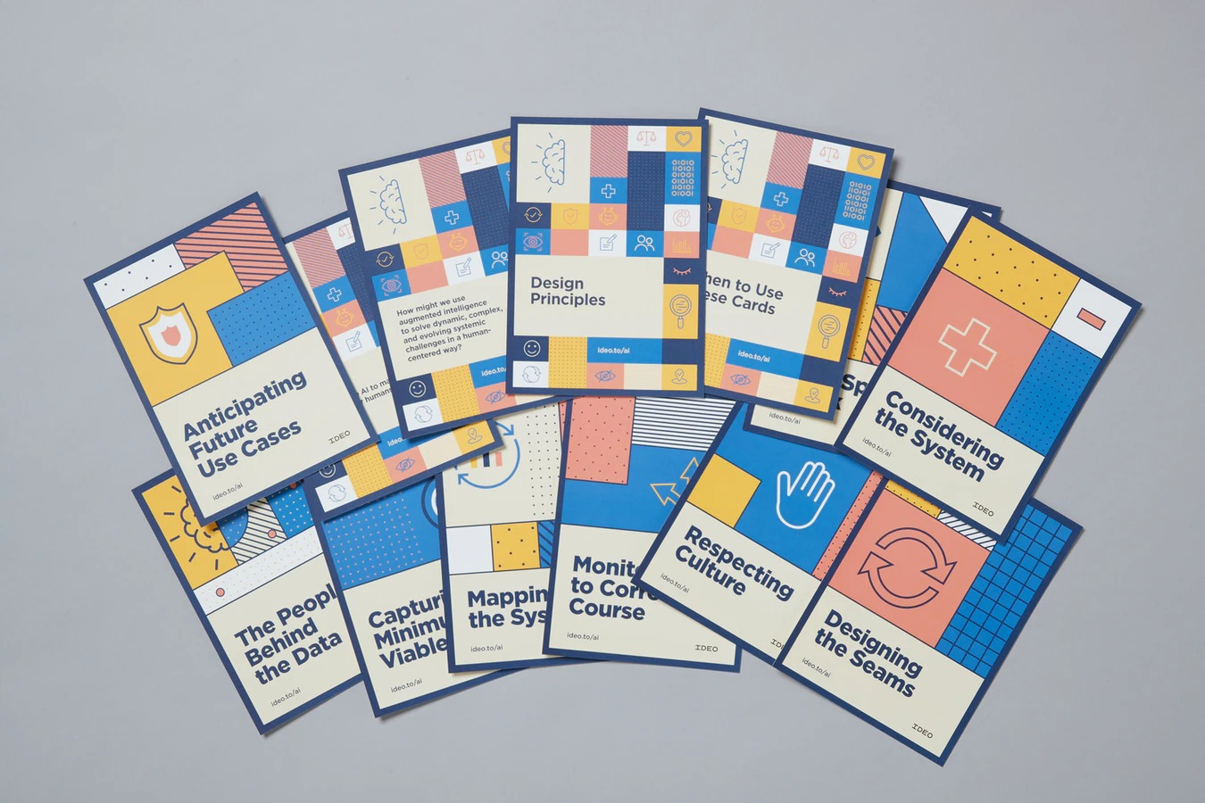

Solution identification - Method
2 Card-based Design Frameworks used
AI meets Design Toolkit
AI & Ethics
Card-based methods are not new in “traditional” design, where they are used to inspire the designers, by including a gamification component.

Slide 11


Solution identification
AI x Design Toolkit
Cards called AI x Design Ideation Card Deck consist of 20 What if…? statements that help in the development of ideas based on AI and Machine Learning systems.
These cards represent possible new areas to be exported to improve the user experience.
Each card provides also an example of possible Machine Learning techniques to be used to answer that specific question and a series of examples from which to draw inspiration.
For this project, this tool was chosen in order to find possible solutions to the needs
of our target users.
The focus shifted onto the chosen technologies and using the examples provided by the cards to find ideas and formulate possible solutions to the needs identified in the previous phases of the project.

Slide 12

Solution identification
2. IDEO’s AI Ethic Cards
It is a tool designed to guarantee an ethically-responsible, culturally considerate, and humanistic approach when designing with data.
It consists of four design principles and ten activities, all meant to be used by teams working on the development of new, data-driven, smart products or services
4 Principles of AI Ethic Cards
Data is not truth
Don’t presume the desirability of AI
Respect privacy and the collective good
Unintended consequences of AI are design opportunities

Slide 13



Solution identification- Results
Target user: students with visual impairment
Need: equal education
Facial expression detection
«What if you can sense and respond to your users’ emotions (in real time)?
> It can be useful in order to recognise moments of difficulties while reading and studying in the class or at home
Natural Language Processing - NLP
«What if you can convert across any data type?»
> It could be used to pass from written text to speech language, using text-to-speech systems when detecting difficulties in reading

Slide 14
NATURAL LANGUAGE PROCESSING
FACIAL EXPRESSION DETECTION
Recognition of difficulties The system recognizes a trigger (an expression of difficulty) and helps the user
Text-to-Speech Systems
Automatically convert text to speech so that it can be understood easily by both blind and visually impaired people
Automatic text magnification
While a visually impaired person reads a file (e.g., PDF) the system follows the movement of the eye and automatically enlarges the text.

Slide 15

A little recap…
Users + need
A visually impaired student who may experience problems while reading but still wants to know the content of textbooks and participate in classroom activities.
Solution
An application that using facial expression detection recognizes moments of difficulties while studying in class or at home and automatically magnify the text.
This App is called EasyRead

Slide 16


Pretotyping - Fake Door
Two different uses of fake door to promote our app
Survey
Assess the number of user interested in our solution and collect data about their possible visual impairment and difficulty while reading
Short videos
Two short videos posted on TikTok explaining the functionality of the app that will soon be available in digital stores (@appdeveloperforfuture)
Trying to use popular hashtag and those related to the argument
We didn’t try paid sponsorization
Link to the survey [ITA]
Link to the survey [ENG]
This two solution were also included into a landing page (EasyRead)

Slide 17
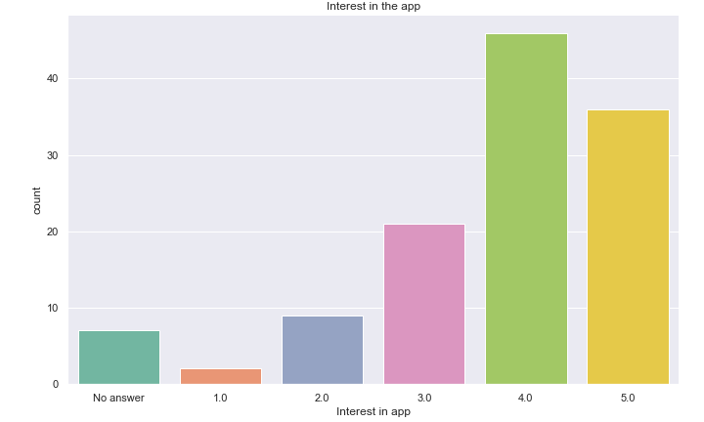
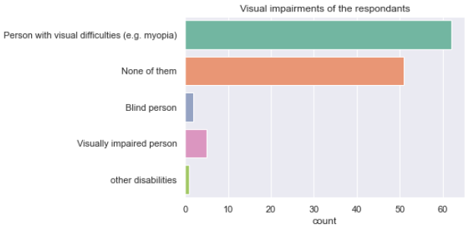
Pretotyping - Results (Survey)
Survey: 121 answers (110 italian survey + 20 english survey)
High interest in app, especially in the Italian survey (72 out of 101 users expressed a level of interest equal to 4)
Interested users are those with visual impairments and diseases and healthy ones
Not all the users are convinced to give the app permission to be filmed while reading, mainly for privacy problems.
Degree of interest in our app (scale 0-5) according to survey
Type of visual impairment according to survey

Slide 18
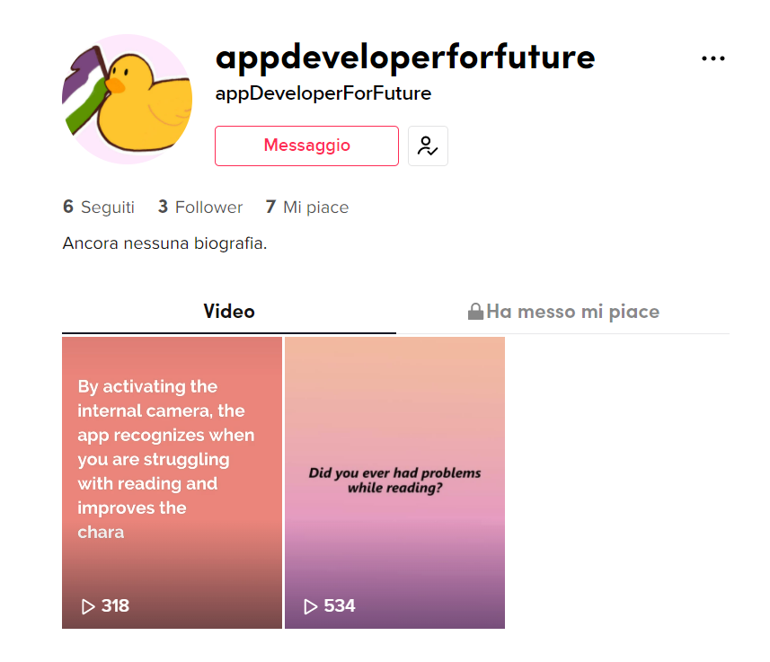
Pretotyping - Results (Videos)
Video 1 (534 views and 2 likes)
Video 2 (321 views and 5 likes)
Good results for not using sponsored posts
Views and likes do not provide a baseline to properly assess user interest in our solution

Slide 19

Conclusions
The Survey
Was useful to concentrate on problems of privacy
Managed to gather more informations about some disease while reading, that may be solved in further steps of design
This reading application has drawn the interest of people, prospective users and users not even considered within this study. However, further investigation and usage of other pretotyping methods are needed for development of a successful product.

Slide 20
Thank you for the attention
Francesca Baudo
Erica Cau
Alice Isola
Carla Lorena Trejo Silva

